Slide 1
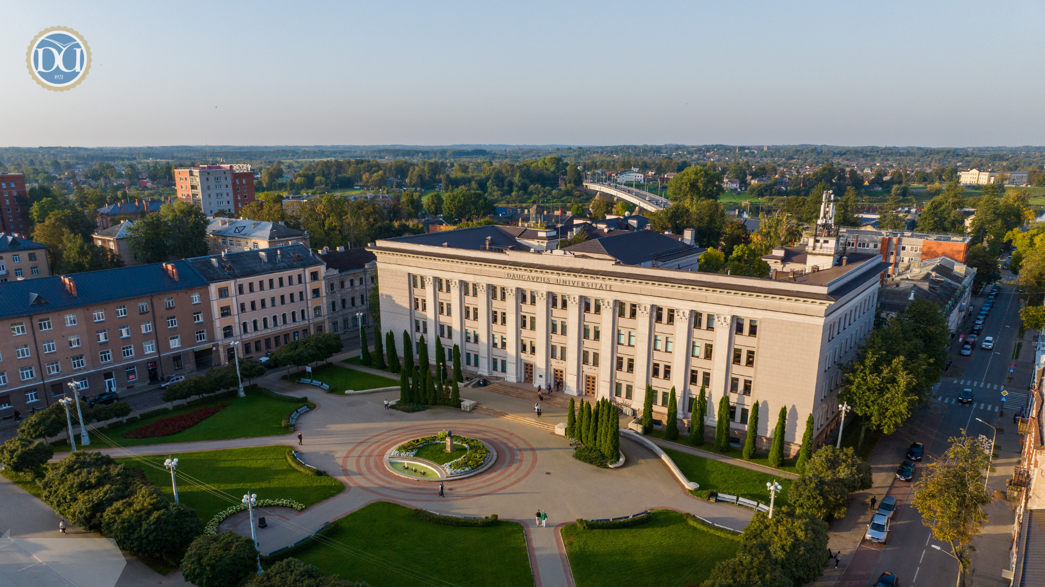

Daugavpils University
Innovation • Education • Collaboration
ANNO 1921

Slide 2
Latvia
LATVIA
  Is one of the Baltic States of Northern Europe.
  Latvia covers an area of 64,589 km2, with a population of nearly 1.8 million.
  Its capital and largest city is Rīga.
  Latvians belong to the ethno-linguistic group of the Balts and speak Latvian, one of the only two surviving Baltic languages.

Slide 3
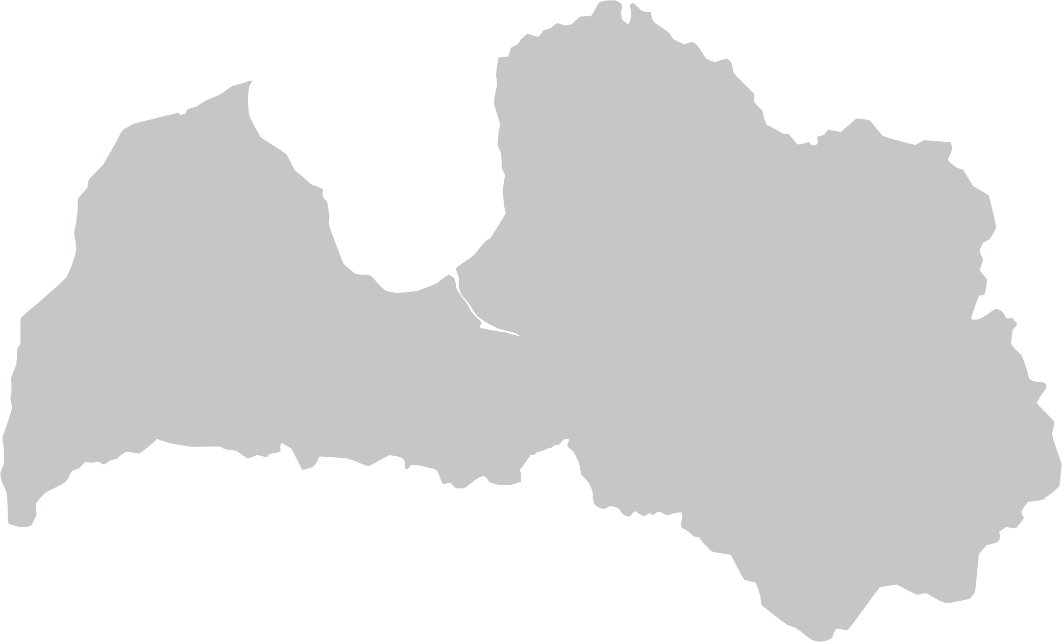

Daugavpils
1
Total Area - 72.48 km²
ANNO
1275
2
The most Eastern location of EU
3
223 km to Riga
25 km to Lithuania
35 km to Belarus
120 km to Russia

Slide 4



Daugavpils
77,486 inhabitants
Ukrainians
Latvians
Russians
Poles
Belarussians
Daugavpils is a multicultural city with exciting history!

Slide 5
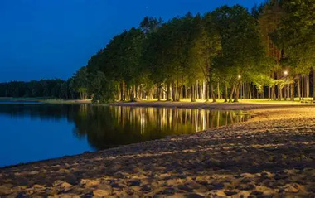
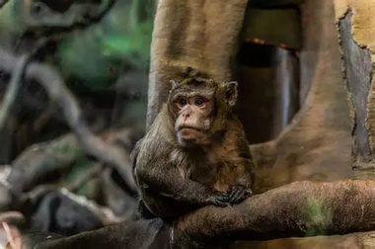
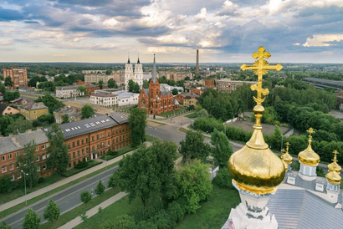
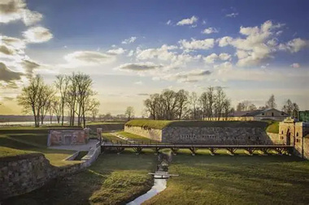
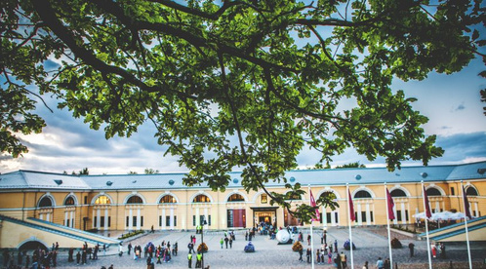
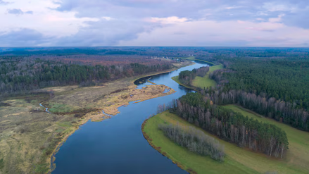
Tourist attractions in Daugavpils
Daugavpils is a beautifully serene place where history and culture intertwine like a quiet poem, offering countless sights to wander, admire and lose yourself within.
Stropi Lake
Latgale zoo
Church Hill
Daugavpils Fortress
Rothko Museum
Daugava River
this is only the beginning-discover many more hidden gems and places that quietly steal your admiration.

Slide 6
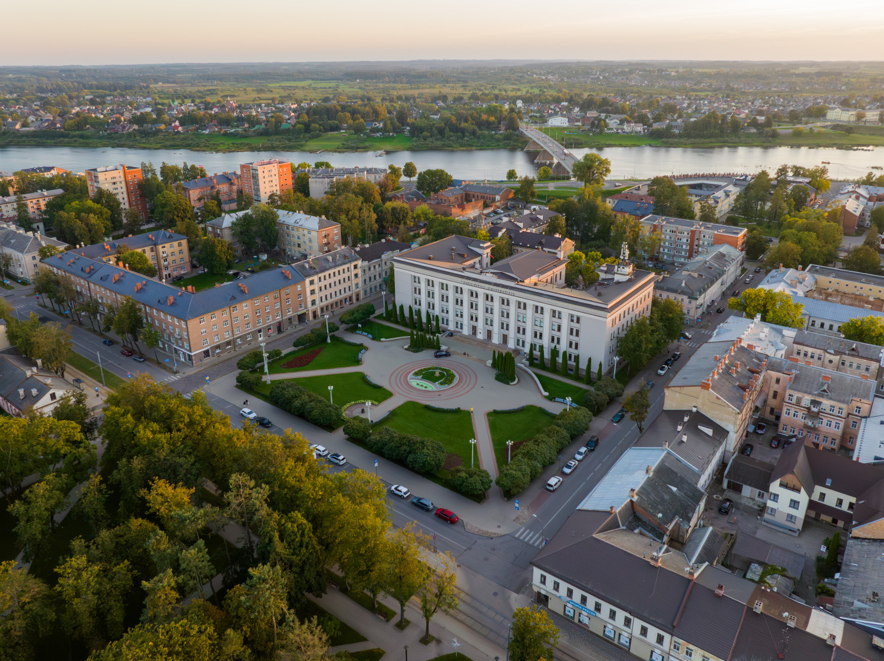
Daugavpils University
history
Daugavpils Pedagogical School
---
Seminary for Teachers
1921
1923
Daugavpils State Teachers’ Institute
1952
Daugavpils Pedagogical Institute
1993
Daugavpils Pedagogical University
2001
Daugavpils University

Slide 7
FACULTIES
at Daugavpils University
FACULTY OF NATURAL SCIENCES
AND HEALTHCARE
FACULTY OF HUMANITIES
AND SOCIAL SCIENCES
      IT
      Physiotherapy
      Nursing Science
      Biology
      Environmental Science
      Chemistry
      Mathematics
      Physics
      Sports
      Pedagogics
      Civil Safety and Defence
      Languages and Culture Studies
      Law
      History
      Eastern European Relations and Integration
      Psychology
      Design and Art
      Music
      Economics
      Management Science

Slide 8


Scientific institutes | structural units
since
2017
LATVIAN INSTITUTE OF AQUATIC ECOLOGY
INSTITUTE OF SOCIAL SCIENCES AND HUMANITIES
since
2018
INSTITUTE OF LIFE SCIENCES AND TECHNOLOGY
DAUGAVPILS MEDICAL COLLEGE

Slide 9
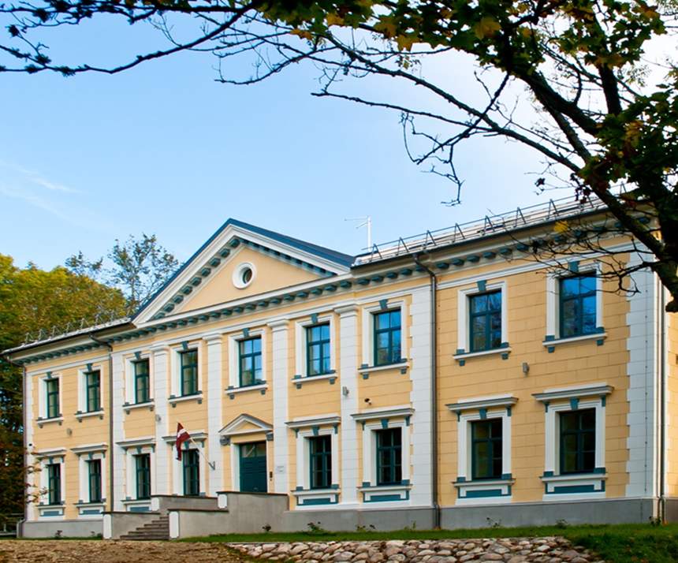
INSTITUTE OF LIFE SCIENCES AND TECHNOLOGY
DEPARTMENT OF BIODIVERSITY
  Study and Research Center “Ilgas”
  Coleopterological Research Center
  Forest Biodiversity Research Center
  Laboratories of Botany (Herbarium), Zoology and Forest Biodiversity
DEPARTMENT OF ECOLOGY
  Laboratory of Hydrobiology
  Laboratory of Aquacultures
  Laboratory of Molecular Biology and Genetics
  Laboratory of Zoocultures and Nature Conservation
  Laboratory of Parasitology and Histology
DEPARTMENT OF TECHNOLOGY
  G.Liberts Innovative Microscopy centre
  Mathematical Research Centre

Slide 10
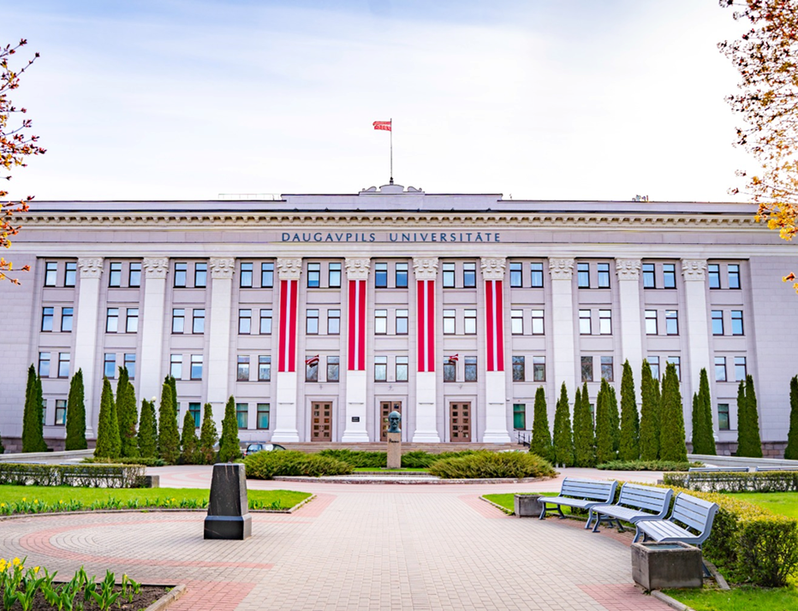
INSTITUTE OF SOCIAL SCIENCES AND HUMANITIES
  Centre of Cultural Research
  Centre of Regional Studies‘’Latgale Research Institute’’
  Centre of Social Research
  Centre of Sustainable Education

Slide 11

CENTRE OF LIFELONG EDUCATION
  face-to-face and online professional development programmes
  face-to-face English language training courses
  face-to-face Chinese language and culture courses
  short courses in inclusive education, digital technologies

Slide 12
UNITS FOR RESEARCH
RESEARCH AND BUSINESS CENTER «REBUS»
UNESCO CHAIR
since 2013
DOCTORAL SCHOOL
9 PROMOTIONAL COUNCILS

Slide 13

INTERNATIONAL SCIENTIFIC CONFERENCES
BIOLOGICAL DIVERSITY RESEARCH
SCIENTIFIC READINGS IN HUMANITIES
SPORT: EDUCATION, SCIENCE, TECHNOLOGIES
MUSIC SCIENCE TODAY
INTERNATIONAL ACADEMIC CONFERENCE – SOCIAL SCIENCES FOR REGIONAL DEVELOPMENT
INTERNATIONAL RESEARCH CONFERENCE – SLAVIC READINGS
1
DAUGAVPILS UNIVERSITY ANNUAL INTERNATIONAL SCIENTIFIC CONFERENCE

Slide 14
SCIENTIFIC ACHIEVEMENTS | 2025
15
scientific periodicals
242
scientific publications
WoS | SCOPUS
286 staff members:
Academic staff (75% with Doctoral Degree)
Administrative Staff
Maintenance Staff
75
projects and contracts

Slide 15
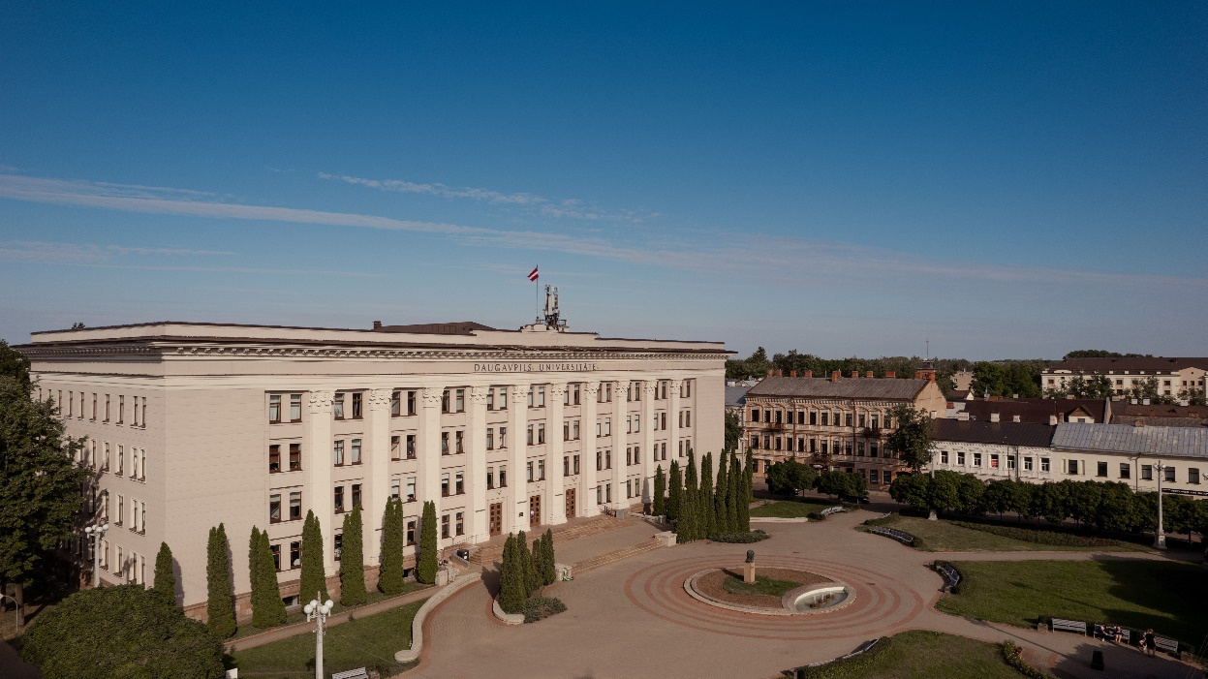
INTERNATIONALISATION
at Daugavpils University
  274 inter-institutional agreements within the Erasmus+ KA 131 project (EU countries)
  47 inter-institutional agreements within the Erasmus+ KA 171 project (non-EU countries)
  Fulbright programme
  English fellow programme

Slide 16
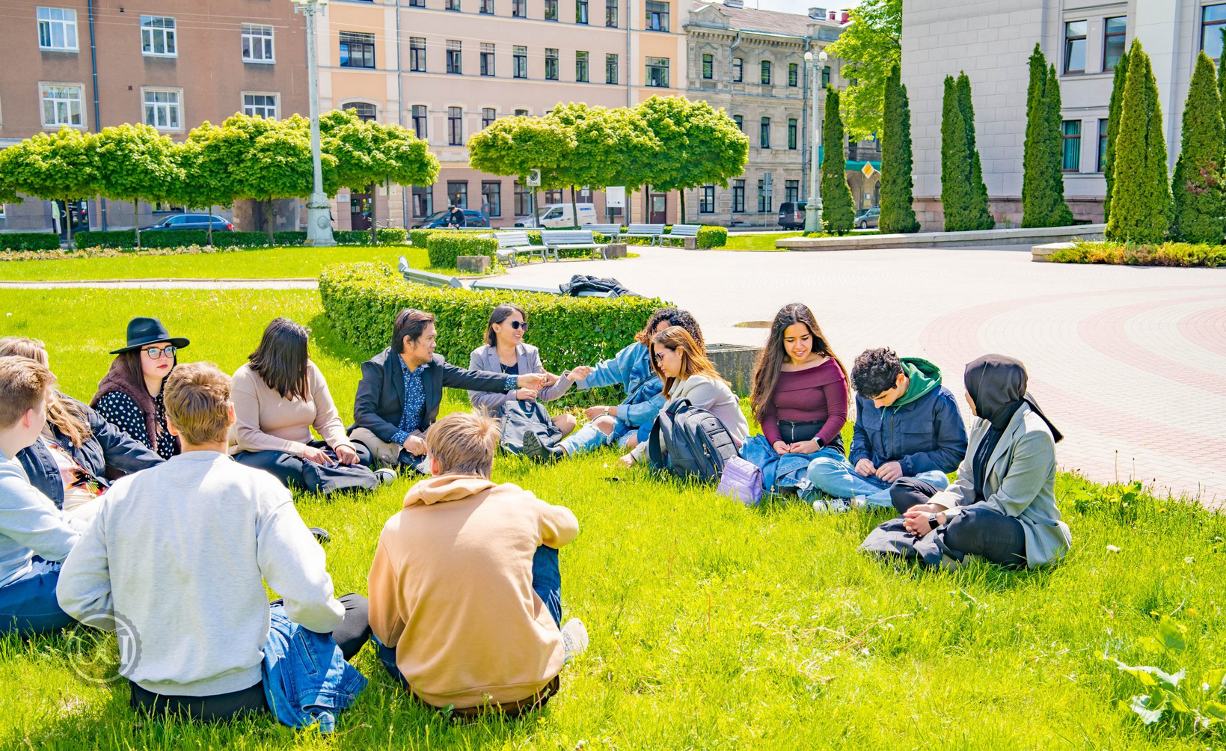
Students
>3000 students
Full-time students
Bangladesh, China, Finland, Germany, Greece, India, Jamaica, Lithuania, Nigeria, Pakistan, Poland, Philippines, Sri Lanka, Tajikistan, Ukraine, Uzbekistan
Erasmus+ KA 131 / 171
Exchange students

Slide 17
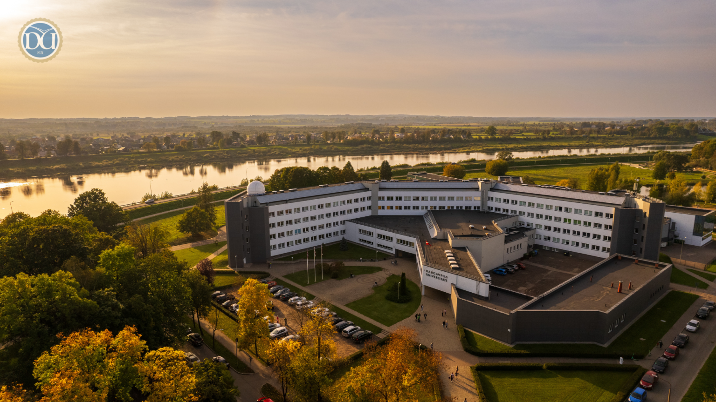
Rankings and Recognition:
DU is included in several international ranking systems, including EHESO, QS World University Rankings, UniRank and EduRank where it ranks #4 among universities in Latvia.
Best Practice University Status:
DU is also recognised as a “Best Practice University” highlighting its commitment to quality education and international standards.

Slide 18
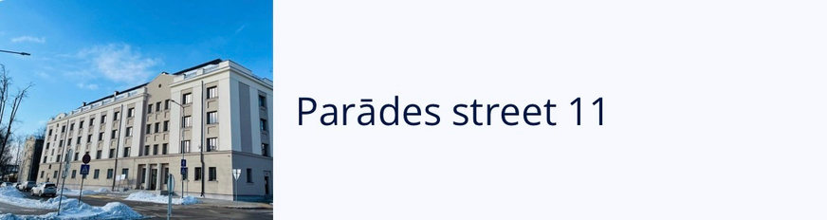
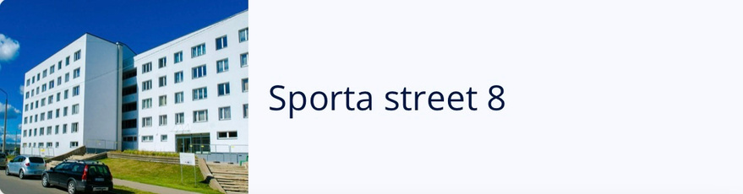
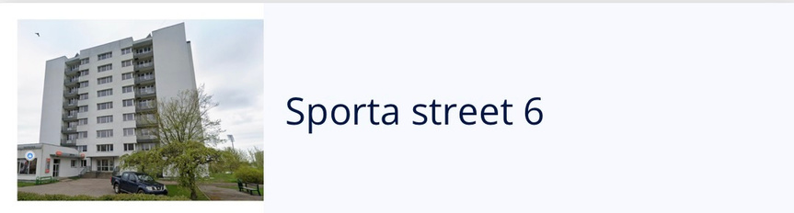
Student Dormitories
Daugavpils University offers comfortable student dormitories located near the university, providing convenient and affordable living for students.
Key features:
→ Well-located student housing near university facilities
→ Furnished rooms and shared amenities
→ Supportive student community environment
Price range:
€65–€200 per month
→ among the cheapest student accommodation options in Latvia

Slide 19
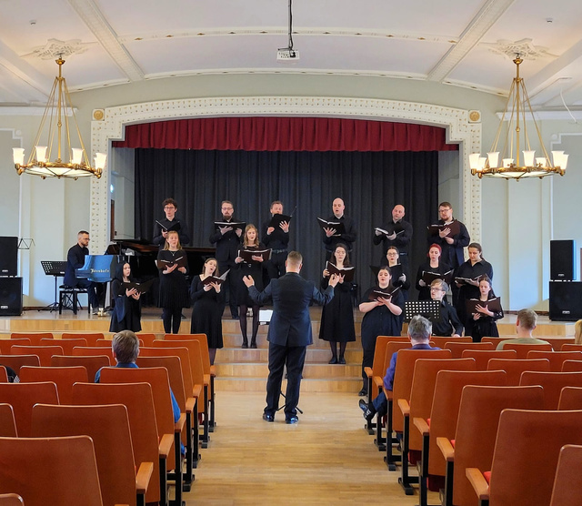
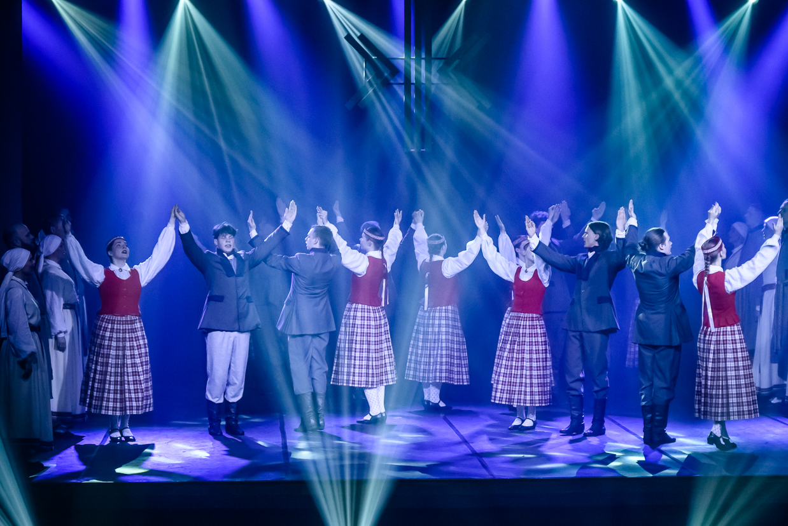
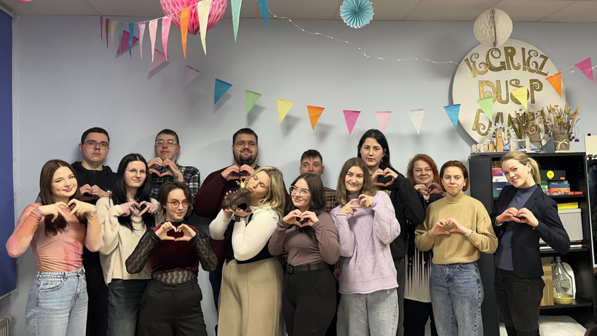

Opportunities for DU Students
Daugavpils University provides a supportive and active student environment with many opportunities for academic, cultural, and personal development:
Mixed choir “DUalis”
Dance ensemble “Laima”
Students’ council
Latvian language learning support for international students
Erasmus+ study and traineeship mobility programmes
Scholarships and financial support opportunities, including Latvian state scholarships
Affordable tuition fees compared to many EU universities
Access to student support services and medical care facilities
Active student life with clubs, events, and international community activities
Opportunities for research involvement and academic development across faculties

Slide 20
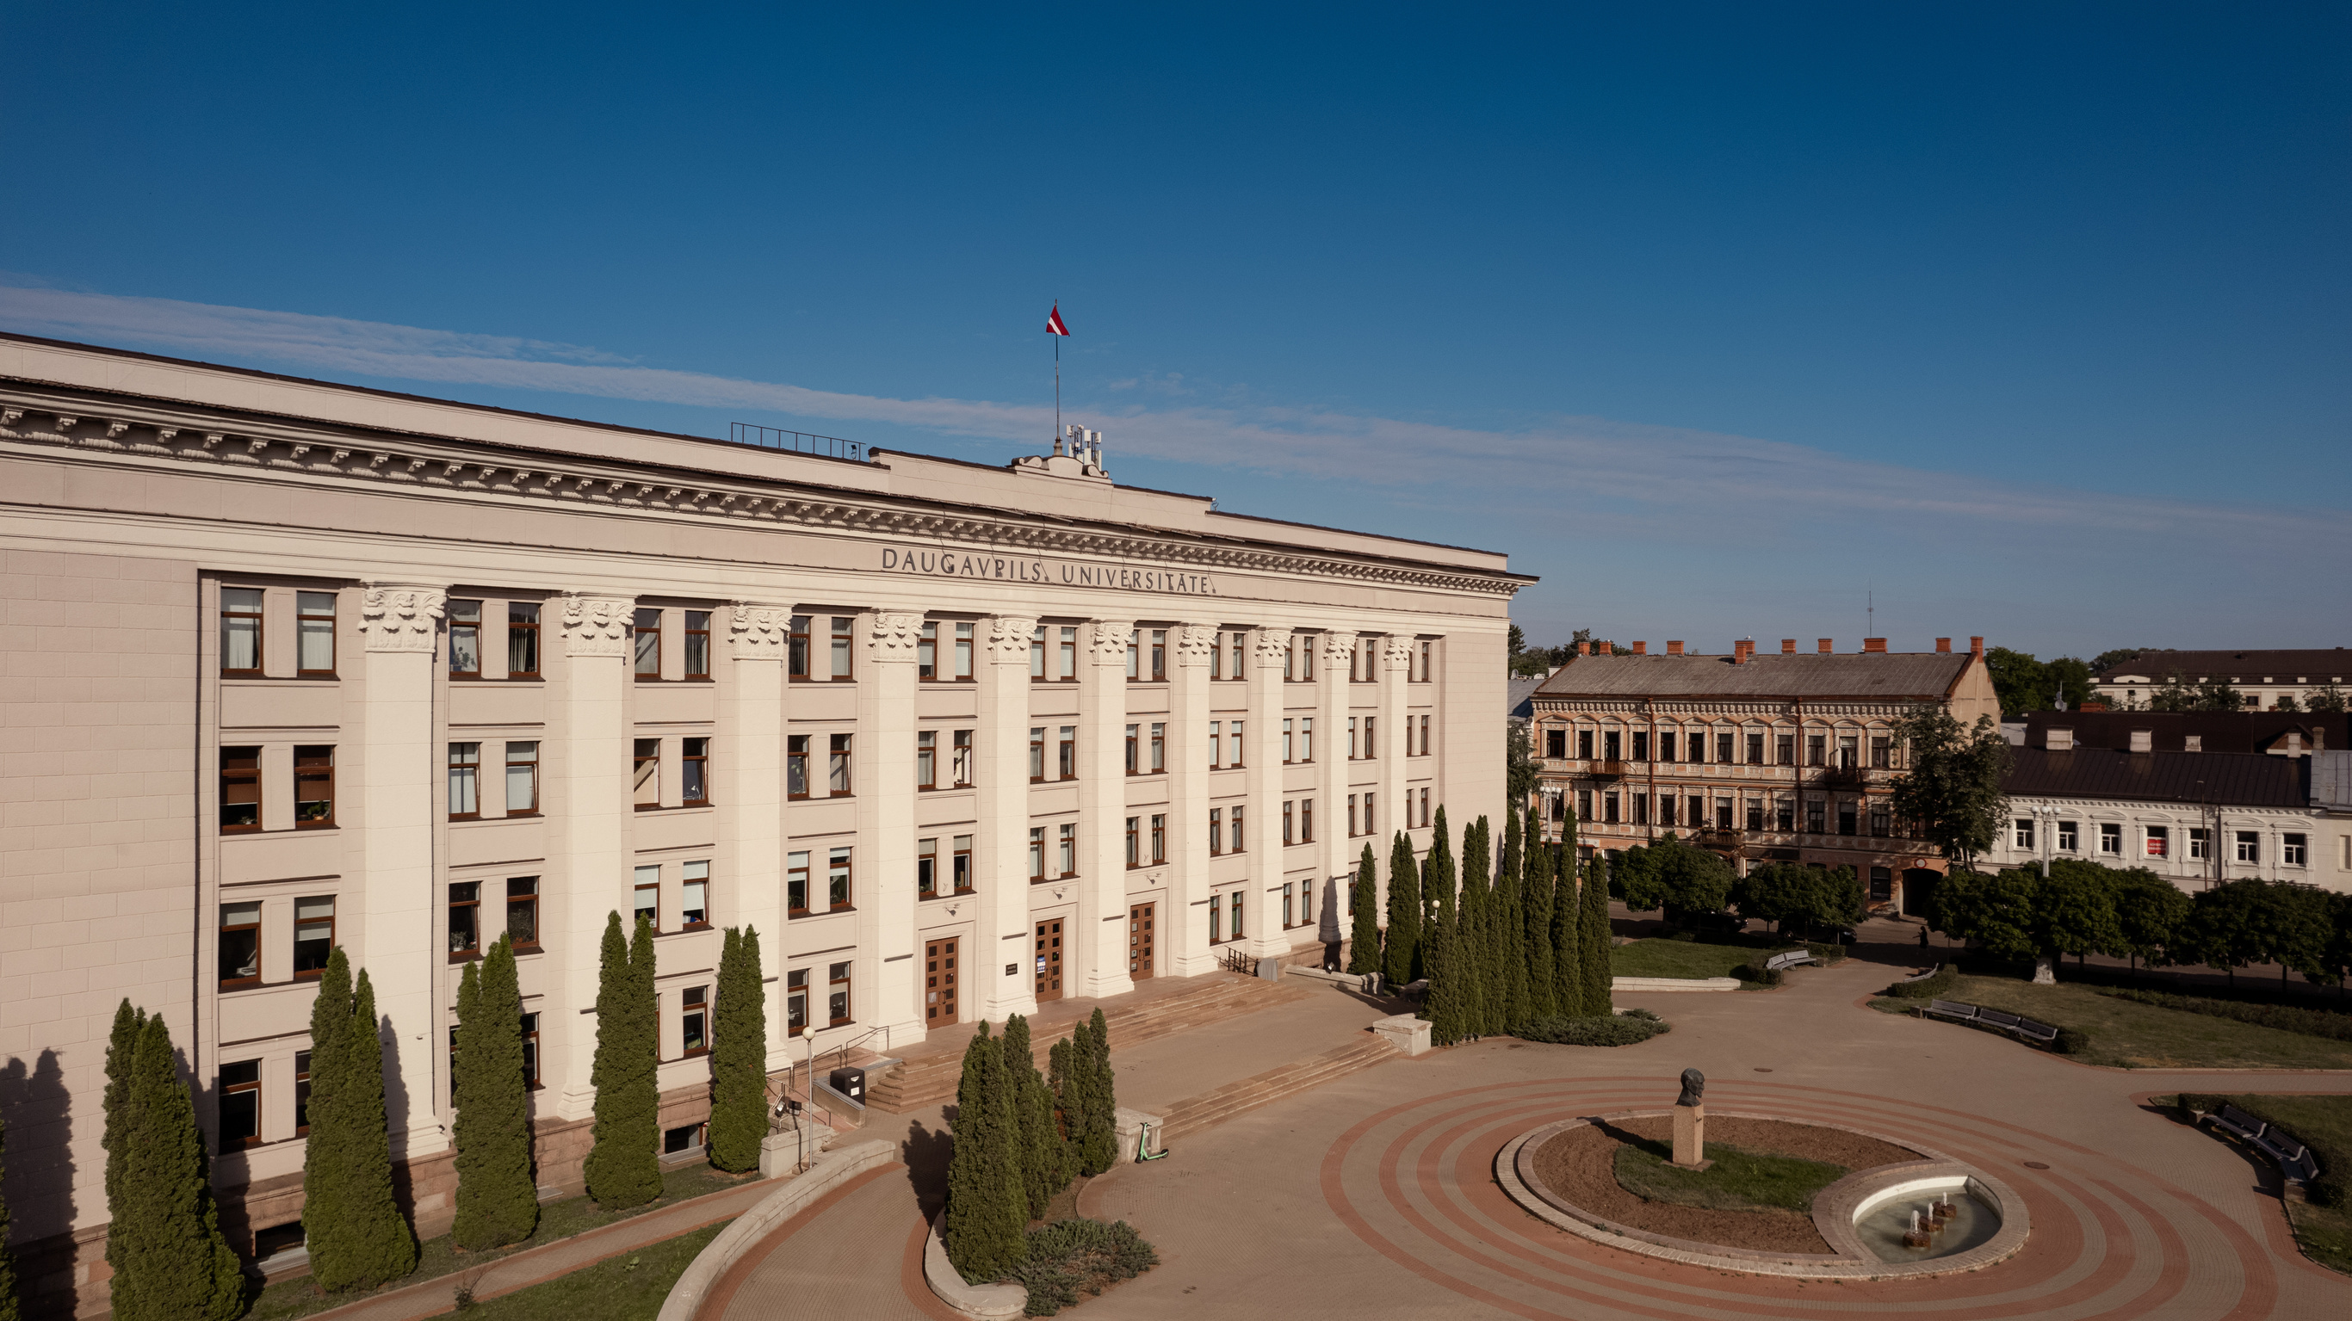


Scientia Vinces = Through Knowledge You Win!!
Welcome to Daugavpils University
www.du.lv
Daugavpils Universitāte
Daugavpils-Universitate
DaugavpilsUniversitate
DaugavpilsUniversitate

