Slide 1
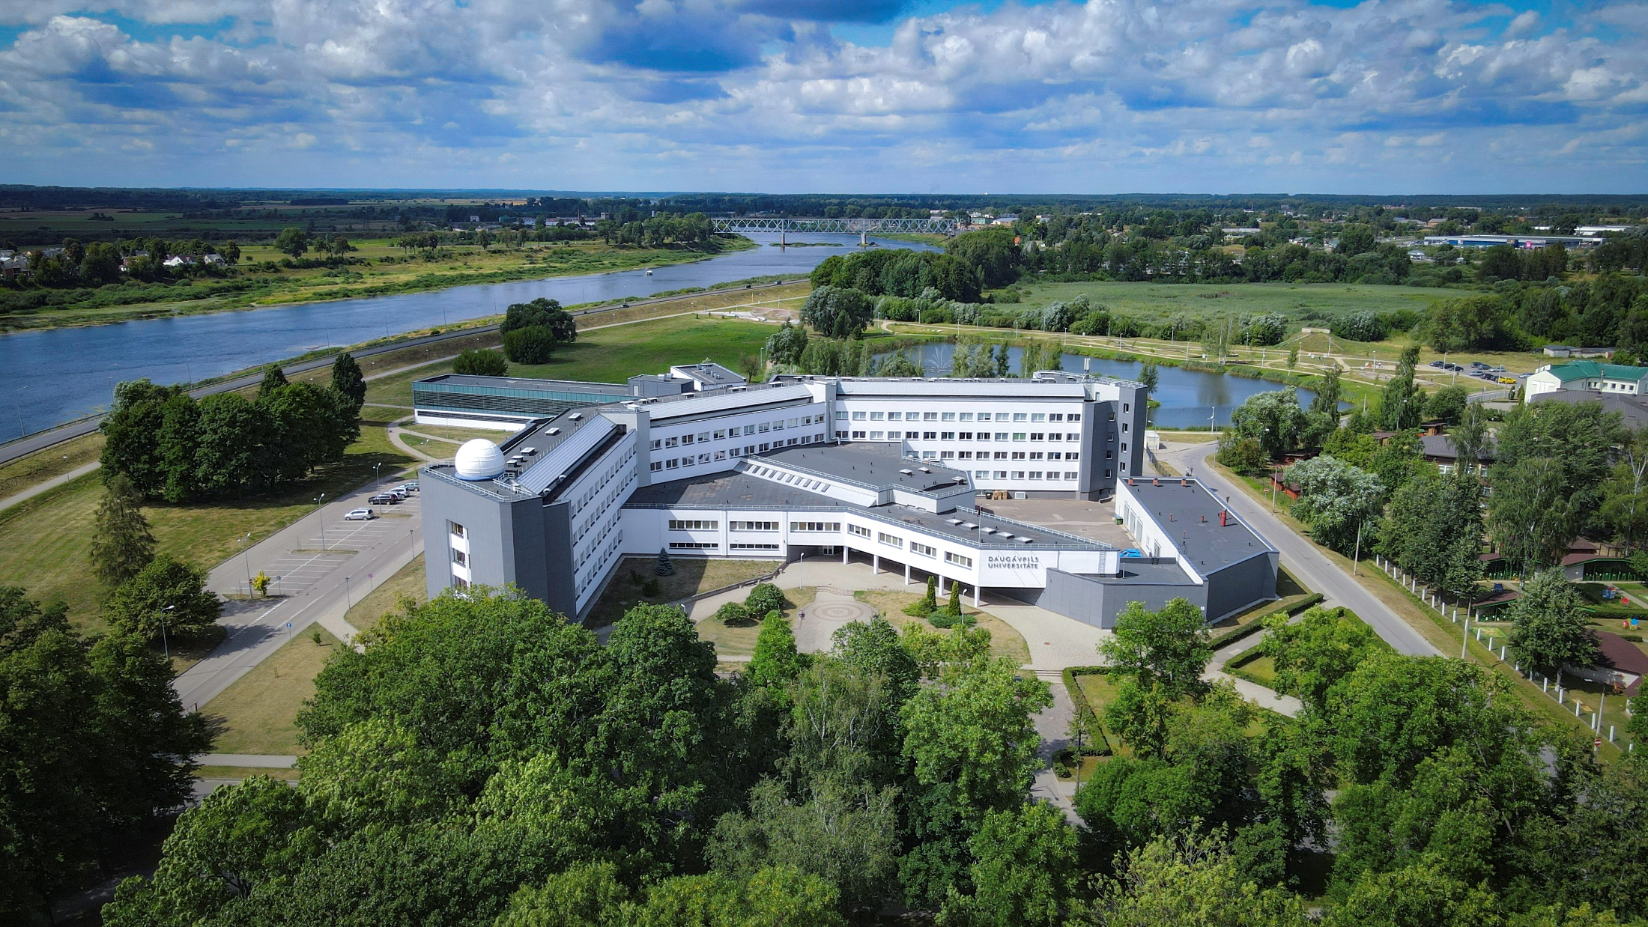

DAUGAVPILS UNIVERSITY
ANNO 1921

Slide 2
Latvia
Is one of the Baltic States of Northern Europe.
Latvia covers an area of 64,589 km2, with a population of nearly 1.8 million.
Its capital and largest city is Rīga.
Latvians belong to the ethno-linguistic group of the Balts and speak Latvian, one of the only two surviving Baltic languages.
LATVIA

Slide 3

DAUGAVPILS
ANNO 1275
Total area - 72.48 km²
223 km to Riga
25 km to Lithuania
35 km to Belarus
120 km to Russia
The most Eastern location of EU
DAUGAVPILS

Slide 4
daugavpils
78,300 inhabitants
Ukrainians
Latvians
Russians
Poles
Belarussians
Daugavpils is a multicultural city with exciting history!

Slide 5
Daugavpils University
history
1921
1923
1952
1993
2001
Daugavpils Pedagogical School
---
Seminary for Teachers
Daugavpils State Teachers’ Institute
Daugavpils Pedagogical Institute
Daugavpils Pedagogical University
Daugavpils University

Slide 6


faculties
FACULTY OF NATURAL SCIENCES
AND HEALTHCARE
FACULTY OF HUMANITIES
AND SOCIAL SCIENCES
IT
Physiotherapy
Nursing Science
Biology
Environmental Science
Chemistry
Mathematics
Physics
Sports
Pedagogics
Civil Safety and Defence
Languages and Culture Studies
Eastern European Relations and Integration
History
Law
Psychology
Design and Art
Music
Economics
Management Science

Slide 7
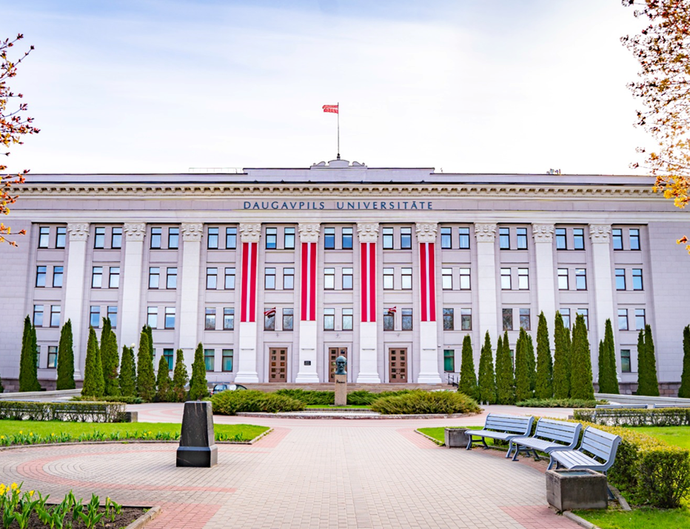
STUDENTS
2900 students
Azerbaijan, Bangladesh, China, India, Israel, Jamaica, Kyrgyzstan, Lesotho, Nigeria, Tajikistan, Pakistan, Philippines, Poland, Portugal, Sri Lanka, Turkey, Ukraine, USA, Uzbekistan
Full-time students
Erasmus+ KA 131 / 171
Exchange students

Slide 8
INTERNATIONALISATION
234 inter-institutional agreements within the Erasmus+ KA 131 project (EU countries) 15 inter-institutional agreements within the Erasmus+ KA 171 project (non-EU countries) Fulbright programme English fellow programme

Slide 9
Scientific institutes | structural units
INSTITUTE OF LIFE SCIENCES AND TECHNOLOGY
INSTITUTE OF SOCIAL SCIENCES AND HUMANITIES
LATVIAN INSTITUTE OF AQUATIC ECOLOGY
DAUGAVPILS MEDICAL COLLEGE
since
2017
since
2018

Slide 10
INSTITUTE OF LIFE SCIENCES AND TECHNOLOGY
DEPARTMENT OF BIODIVERSITY
Study and Research Center “Ilgas”
Coleopterological Research Center
Laboratory of Botany (Herbarium)
Laboratory of Zoology
Laboratory of Forest Biodiversity

Slide 11
INSTITUTE OF LIFE SCIENCES AND TECHNOLOGY
DEPARTMENT OF ECOLOGY
Laboratory of Hydrobiology
Laboratory of Aquacultures
Laboratory of Molecular Biology and Genetics
Laboratory of Zoocultures and Nature Conservation
Laboratory of Parasitology and Histology

Slide 12
INSTITUTE OF LIFE SCIENCES AND TECHNOLOGY
DEPARTMENT OF TECHNOLOGY
G. Liberts Innovative Microscopy Centre
Mathematical Research Centre

Slide 13
INSTITUTE OF SOCIAL SCIENCES AND HUMANITIES
Centre of Cultural Research
Centre of Regional Studies ‘’Latgale Research Institute’’
Centre of Social Research
Centre of Sustainable Education

Slide 14

SCIENTIFIC ACHIEVEMENTS | 2024
80
projects and contracts
235
scientific publications
WoS | SCOPUS
15
scientific periodicals
75% of academic staff with doctoral degree

Slide 15

PROJECTS
HORIZON EUROPE
research and innovation
ERA-NET
national and regional research
LIFE
environment and climate

Slide 16
UNITS FOR RESEARCH
RESEARCH AND BUSINESS CENTER «REBUS»
UNESCO CHAIR
since 2013
DOCTORAL SCHOOL
9 PROMOTIONAL COUNCILS

Slide 17
INTERNATIONAL SCIENTIFIC CONFERENCES
SCIENTIFIC READINGS IN HUMANITIES
BIOLOGICAL DIVERSITY RESEARCH
SPORT: EDUCATION,
SCIENCE, TECHNOLOGIES
MUSIC SCIENCE TODAY
INTERNATIONAL ACADEMIC CONFERENCE – SOCIAL SCIENCES FOR REGIONAL DEVELOPMENT
INTERNATIONAL RESEARCH CONFERENCE – SLAVIC READINGS
DAUGAVPILS UNIVERSITY ANNUAL INTERNATIONAL SCIENTIFIC CONFERENCE

Slide 18
Daugavpils Universitāte
DU_LV
Daugavpils University
www.du.lv

