Slide 1


Slide 2


Dienas kārtība
  Ieskats projektā, kas mēs esam un ko daram!
  Diskusija: Diskusijas laikā tiks apspriestas vadlīnijas un idejas, kā izveidot apmācības (training) programmu, tās saturu jauniem pētniekiem, zinātniekiem, metodiķiem un koordinatoriem (mentoriem). Mēs aicinām jūs aktīvi piedalīties un dalīties ar savu pieredzi, prasmēm un idejām šajā diskusijā.
  Iepazīšanās ar BETTER Life Digitālo centru: Uzziniet par jaunā Digitālā centra izveides procesu un tā nozīmi BETTER Life projekta kontekstā.
  Projekta rezultātu prezentācija: Apkopojam gada garumā sasniegtos rezultātus un sniedzam ieskatu projekta virzībā. Dalībnieki tiks iepazīstināti ar galvenajām atziņām, secinājumiem un turpmākajiem soļiem.
  Jautājumi / atbildes, ierosinājumi, komentāri.

Slide 3

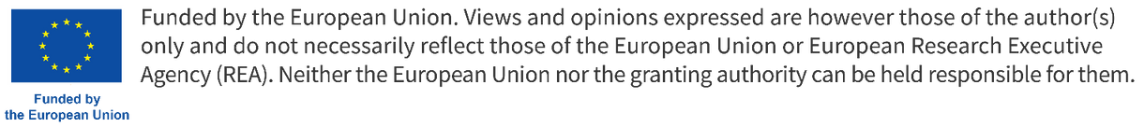
“Praksē bāzētu dzīvības zinātņu pētījumu attīstība:
sabiedrības līdzdalība un sadarbības platformas veidošana”

Slide 4









9 partneriestādes
CZECH UNIVERSITY OF LIFE SCIENCES PRAGUE (CZU)
Czechia
MARTIN LUTHER UNIVERSITY HALLE-WITTENBERG (MLU)
Germany
UNIVERSITY OF CAMERINO (UNICAM)
Italy
ACCREDITATION COUNCIL FOR ENGAGED AND
ENTREPRENEURIAL UNIVERSITIES (ACEEU)
Germany
ESTONIAN UNIVERSITY OF LIFE SCIENCES (EMU)
Estonia
DAUGAVPILS UNIVERSITY (DU)
Latvia
POZNAN UNIVERSITY OF LIFE SCIENCES (PULS)
Poland
HELIXCONNECT EUROPE (HELIXCONNECT)
Romania
EDUCONS UNIVERSITY (EDUCONS)
Serbia

Slide 5

HORIZON-WIDERA-2021-ACCESS-05-01
Valsts iestādes
Pašvaldības
NVO
Uzņēmēji
Agrīnās karjeras pētnieki

Slide 6

KĀPĒC?
Digitālais izcilības centrs (DCoE) atbalstīs sabiedrības iesaistītās pētniecības pieejas attīstību DU un reģionā:
  lai veidotu sadarbības platformu starp DU/zinātniekiem un sabiedrību – uzņēmējiem, NVO, valsts un pašvaldības iestādēm u.c.;
  lai atbalstītu agrīnās karjeras pētniekus, strādājot saistīti ar
sabiedrības problēmām;
  lai piedāvātu dažādus resursus, piemēram, rīku komplektus, lai veicinātu sabiedrības iesaistīto pētniecību;
  lai piedāvātu kapacitātes veidošanas struktūru, lai uzlabotu zināšanas, prasmes un kompetences;
  Kopumā veicinātu saikni starp zinātni un sabiedrību, ļaujot pētniekiem aktīvi risināt reālas problēmas.

Slide 7

Diskusija
Vadlīnijas, priekšlikumi un idejas, kā izveidot apmācības (training) programmu, tās saturu jauniem pētniekiem, zinātniekiem, metodiķiem un koordinatoriem (mentoriem).
Aicinām jūs aktīvi piedalīties un dalīties ar savu pieredzi, prasmēm un idejām šajā diskusijā.
Mērķis - Bootcamps interaktīvo semināru cikla programmas izstāde

Slide 8



Bootcamps
Knowlegde
Skills
Competence
Zināšanas
Prasmes
Kompetences

Slide 9
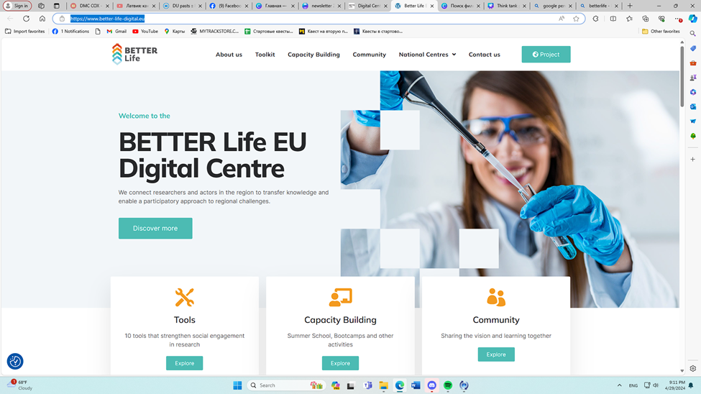
BETTER Life Digitālais centrs

Slide 10
KAS TAS IR?
Digitālais izcilības centrs (DCoE) atbalstīs sabiedrības iesaistītās pētniecības pieejas attīstību DU un reģionā:
  lai veidotu sadarbības platformu starp DU/zinātniekiem un sabiedrību – uzņēmējiem, NVO, valsts un pašvaldības iestādēm u.c.;
  lai atbalstītu agrīnās karjeras pētniekus, strādājot saistīti ar
sabiedrības problēmām;
  lai piedāvātu dažādus resursus, piemēram, rīku komplektus, lai veicinātu sabiedrības iesaistīto pētniecību;
  lai piedāvātu kapacitātes veidošanas struktūru, lai uzlabotu zināšanas, prasmes un kompetences;
  Kopumā veicinātu saikni starp zinātni un sabiedrību, ļaujot pētniekiem aktīvi risināt reālas problēmas.

Slide 11
Deliverable 6.1
Dissemination and Visibility Plan
Lead part for deliverable: Daugavpils University (DU)

Slide 12
DU loma WP6
Aktīvi izplatīt visus projekta rezultātus plašam ieinteresēto personu lokam reģionālā un starptautiskā līmenī, kas ir tiešie ieguvēji no projekta darbībām, kā arī galvenajām mērķgrupām izplatīšanas darbībām.
Lai maksimāli palielinātu redzamību, zīmolu un galvenos intelektuālos rezultātus

Slide 13
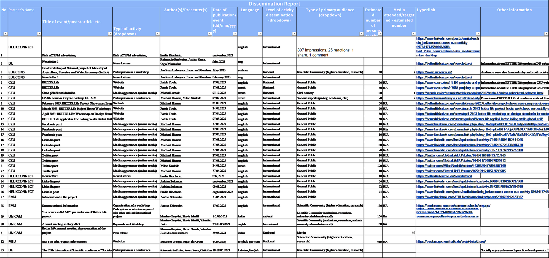
Projekta rezultātu prezentācija

Slide 14
  The dissemination and communication activities are categorized into several types:
Workshops and Conferences:
They involve presentations, panel discussions, and networking opportunities. In the context of a project, workshops and conferences can be used to share project results, gather feedback, and engage with stakeholders.
The events like the “Final workshop of National project of Ministry of Agriculture, Forestry and Water Economy (Serbia)”, “CZ-SK seminář k výzvě nástroje EEI 2023”, “BETTER Life: Work-shop on Design Standards for Socially Engaged Research in Life Sciences”, “The 26th Interna-tional Scientific conference ‘Society and Culture: Genesis of Values and their Transformation’”, and “Presenting the BETTER Life project at CEESME conference in Budapest, 12 to 15 of Sep-tember”,The Participation in the Opening of the Magdeburg Elbfabrik.
"La ricerca in SAAD": presentation of Better Life project
Participation in the 18th INTERNATIONAL ENERGY FAIR, 19th INTERNATIONAL ENVIRONMENT PROTECTION AND NATURAL RESOURCES FAIR – ECOFAIR (Jelena Jesic - EDUCONS), Monitoring meeting of the project GREENLAND, etc.
Meetings of project team members or stakeholders. Meetings can be used for various purposes such as planning, reviewing progress, making decisions, and coordinating activities. They are essential for keeping everyone involved in the project informed and aligned.
The events like the “Annual meeting in Italy 2023”, “Board of the Directors of the Faculty of environmental protection”, “Board of the Directors of the Faculty of ecological agriculture”, and “June’s Board of Directors Meeting of the Faculty of Environmental Protection at Educons University”.
Social Media Posts on such social media platforms like Facebook, LinkedIn, Twitter, and Insta-gram. They can be used to share project updates, promote events, engage with the public, and raise awareness about the project.
Newsletters and E-zines, the regular publications that are sent out to a list of subscribers. They contain news, updates, and other content related to the project. Newsletters and e-zines are a great way to keep stakeholders and the public informed about the project’s progress and achievements.
These include “Newsletter 1”, “BETTER Life E-Zine: May, 2023 Issue #1”, and “Newsletter 2”

Slide 15
  The dissemination and communication activities are categorized into several types:
Newsletters and E-zines, the regular publications that are sent out to a list of subscribers. They contain news, updates, and other content related to the project. Newsletters and e-zines are a great way to keep stakeholders and the public informed about the project’s progress and achievements.
These include “Newsletter 1”, “BETTER Life E-Zine: May, 2023 Issue #1”, and “Newsletter 2”
Special Events: These are unique or one-off events that are organized for a specific purpose. Special events can be used to launch a project, celebrate milestones, or engage with the public in a different way.
These include “Kick off TPM advertising”, “Opening of the Magdeburg Elbfabrik”, and “18th INTERNATIONAL ENERGY FAIR, 19th INTERNATIONAL ENVIRONMENT PROTECTION AND NATURAL RESOURCES FAIR – ECOFAIR”.
Presentations and Lectures: These involve speaking to an audience about the project. Presentations and lectures can be given at conferences, workshops, universities, or other venues. They are a good way to share knowledge, present research findings, and raise awareness about the project.
These include “La ricerca in SAAD: presentation of Better Life project” and “Special lecture at NIRMA university, Ahmedabad, India”.
Media Appearances- involve appearing in traditional media outlets like newspapers, TV, and radio. Media appearances can be used to reach a wider audience, raise awareness about the project, and share important updates or results.
These include “Article on Corriere Adriatico (local newspaper printed and online)”, “Videoreport on Unicam News”, and “Media appearance on national TV”.

Slide 16
Newsletters
Newsletter 1 - 2023.gada februārī
Newsletter 2 - 2023.gada septembrī
Newsletter 3 - 2024.gada janvārī
nākamie pēc plāna:
Newsletter 4 - 2024.gada jūlijā
Newsletter 5 - 2024.gada decembrī
Newsletter 6 - 2025.gada jūlijā

Slide 17
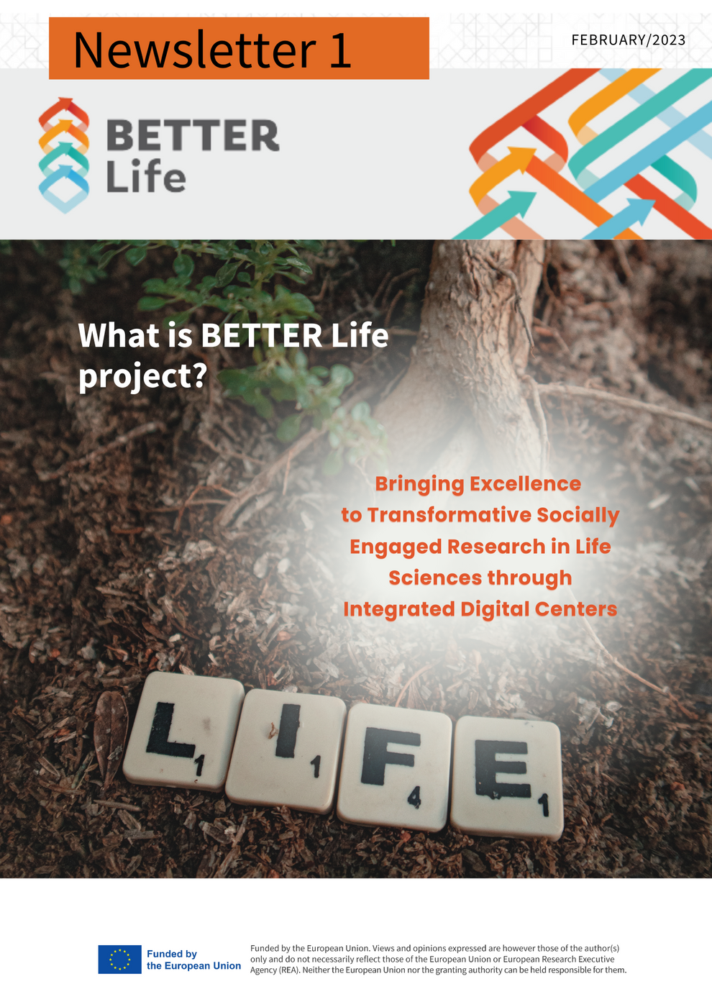
Newsletter 1
The first edition of the newsletter, released in February, this edition is a rich compilation of 11 insightful articles prepared by partners, being responsible for related work tasks, altogether spread across 15 pages. Each article presents various facets of Socially Engaged Research (SER) in Life Sciences, providing readers with a first information and understanding of this field.
The topics of the Newsletter 1 are:
1.What is Socially Engaged Research in Life Sciences?
2.Socially Engaged Research in Life Sciences: An Approach to Tackling Societal Challenges
3.Implementing Socially Engaged Research in Higher Education
4.Status Quo Report on Research and Policies in SER
5.Framing the European Digital Centre of Excellence BETTER Life
6.Socially Engaged Research in Life Sciences in Europe
7.How to Implement SER in Life Sciences
8.Compendium of Innovative Practices on Socially Engaged Research
9.Stakeholder Interactions Launched by Estonian University of Life Sciences
10.Sustainability in BETTER Life
11.News in CZU

Slide 18

Newsletter 2
The second issue of the BETTER Life project newsletter, released in September 2023. This issue, spanning 16 pages, features 12 articles that highlight the project’s progress and achievements over the past year.
The issue was released in September 2023. This adjustment in the timeline demonstrates the consortium’s flexibility and commitment to quality.
The topics of the Newsletter 2 are:
1. Let’s celebrate one year of BETTER Life project
2. Empowering Change: The Roadmap to Socially Engaged Research in Life Sciences:
3. Ten BETTER Life Toolkits have been designed
4. BETTER Life Project Hosts Workshops on Socially Engaged Research in Life Sciences
5. BETTER Life: Workshop on Design Standards for Socially Engaged Research in Life Sciences - April 2023.
6. BETTER Life Holds Second Workshop on Design Standards for Socially Engaged Research in Life Sciences.
7. BETTER Life Project Held Annual Meeting in Italy
8. BETTER Life Meets Local Representatives in Ascoli Piceno.
9. “Cook with Marija and Sanja”- an example of popularization of science to children:
10. News from Educons University
11. BETTER Life co-organizes ENGAGE Summer School in Tartu.
12. Sharing news: The E³UDRES² Ent-r-e-novators project

Slide 19
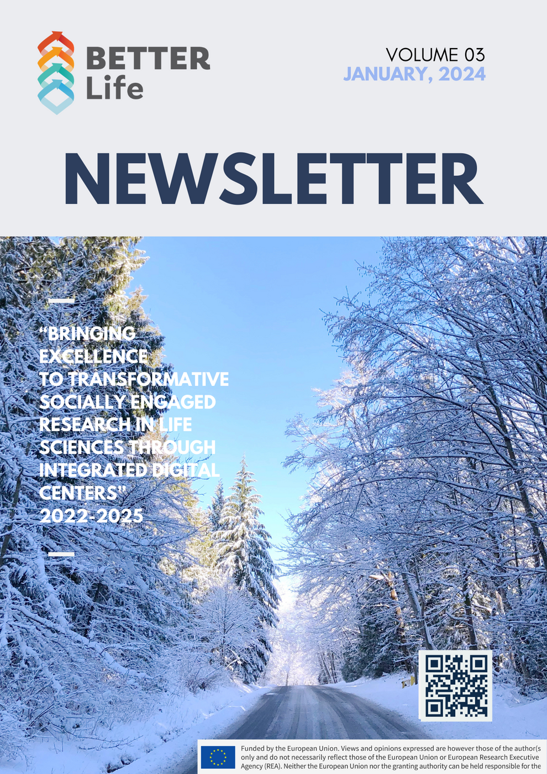
Newsletter 3
The third issue of the BETTER Life project newsletter, released in September 2023. This issue, spanning 15 pages, features 8 articles that highlight the project’s progress and achievements over the past year.
The issue was released in January, 2024.
The topics of the Newsletter 1 are:
  Introduction
  Capacity Building
  Think Tank “Science Pub” at CZU: Academics and Mayors in a Unique Dialogue
  A Digital Centre of Excellence – a showcase for the activities of the BETTER Life project
  SER tools
  Better Life Centres
  A Three-Day Virtual Winter School
  BETTER Life in E³UDRES² Ent-r-e-novators Project Newsletter

Slide 20
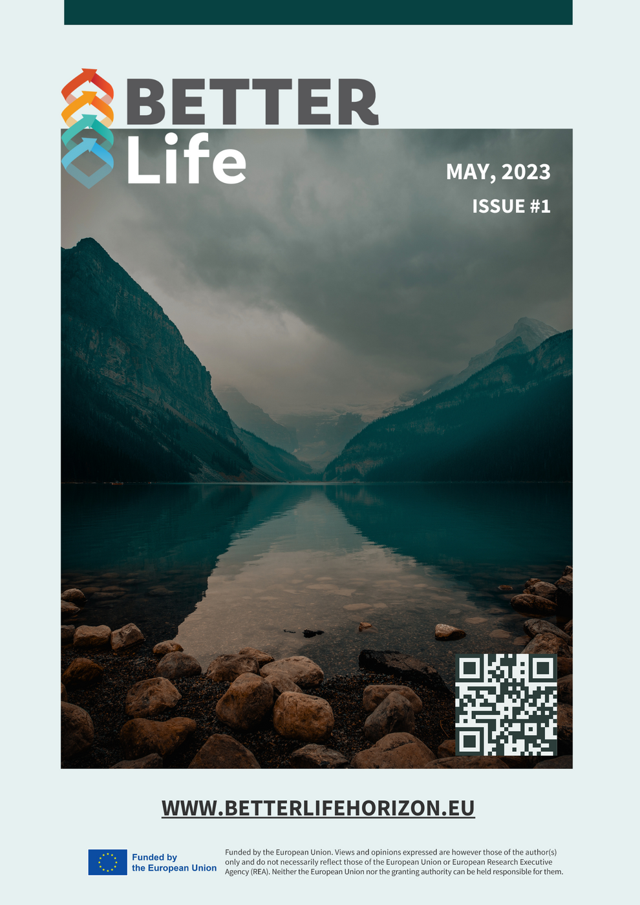
E-ZINE
The released May 2023 issue of the E-ZINE Better Life is the first of e-magazines planned for the project and is a comprehensive document spanning 30 pages. It is meticulously organized into 7 main sections, each further divided into smaller subsections to provide a detailed exploration of various topics. Each section of this E-ZINE contributes to a holistic understanding of SER in life sciences, making it a valuable information resource for anyone interested in this field:
1. A Word from the Leading Partner.
2. Strategic Planning and Governance of EU BETTER Life Centre
3. Designing Framework for SER in Life Sciences
4. Compendium of Innovative Practices on Socially Engaged Research
5. Exploring Consultation Events
6. BETTER Life Co-Organised Summer School on Engaging Science for Better Cities
7. Holding Consultation Events with Quadruple Helix Actors & Mapping Needs, Capacities and Challenges of Regional Ecosystems

Slide 21


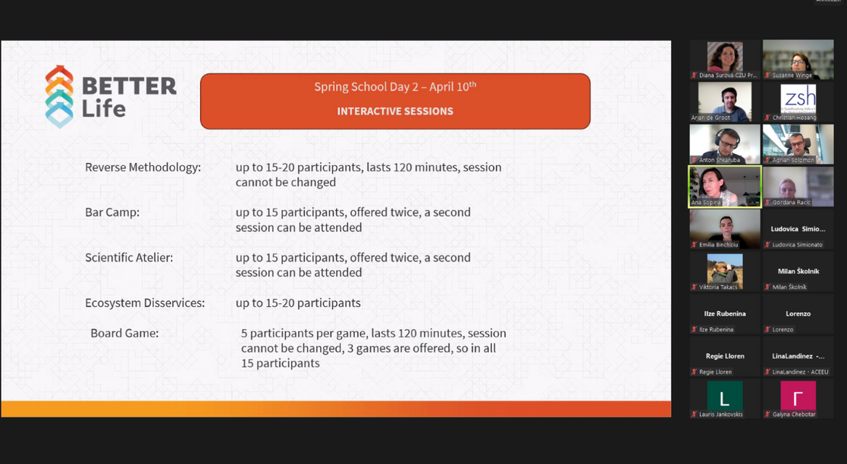
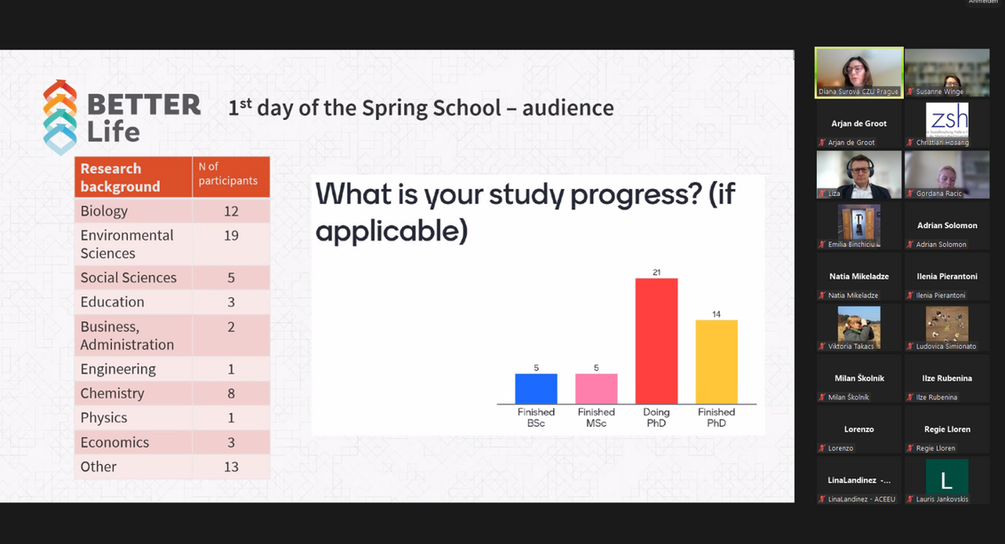
  2 dienas
  ap 70 dalībniekiem no 7 valstīm
  16 no Daugavpils/ Latvijas
  Pirmā diena - teorija, zināšanu nodošana;
  Otrā diena - konkrētu tēmu un izaicinājumu apspriešana dažādās sesijās ar BETTER Life komandu;
  Noslēgumā - izglītojoša galda spēle.

Slide 22
Plānotie darbi:
3 Think Tank semināri

Slide 23
Plānotie darbi:
3 Bootcamps
Knowlegde
Skills
Competence

Slide 24

Plānotie darbi:
Summer School in Prague
2024.gada 9.-15. septembrī

Slide 25




Paldies par dalību!
BETTER Life Facebook
www.betterlifehorizon.eu
BETTER Life Twitter
BETTER Life LinkedIn
www.better-life-digital.eu

Slide 26

Nākošie
SEMINĀRI
THINK TANK
plānojas jūnija sākumā

